Slide 1
Sarla Harshavardhan
Final Project
3/21/2024 Annual Review

Slide 2
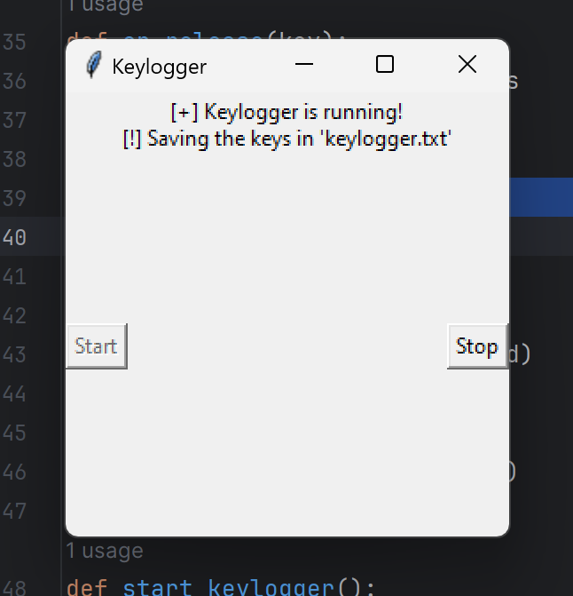
KEY LOGGER
3/21/2024 Annual Review

Slide 3


AGENDA
Project Setup and Research Development and Integration Testing and Enhancement Documentation and Presentation
3/21/2024 Annual Review

Slide 4

PROBLEM STATEMENT
In the modern digital era, keyloggers are frequently used for malicious purposes such as stealing sensitive information including passwords, credit card numbers, and personal messages. Despite their negative connotations, keyloggers can also be utilized for legitimate purposes such as parental monitoring, employee monitoring, or security testing. The main challenge lies in developing a keylogger that can serve ethical purposes while ensuring privacy and security.
3/21/2024 Annual Review

Slide 5

Project Overview: Ethical Keylogger
Objective: Create a Python-based keylogger with a focus on ethical use, privacy, and security.
Setup:
Define objectives and guidelines.
Install Python, pynput, and tkinter.
Development:
Implement keylogging and GUI.
Ensure secure and encrypted logging.
Testing:
Test for accuracy and security.
Add features like timestamps.
Documentation:
Document usage and ethical guidelines.
Prepare a concise report and presentation.
Outcome: A secure, ethical keylogger with a user-friendly interface
3/21/2024 Annual Review

Slide 6
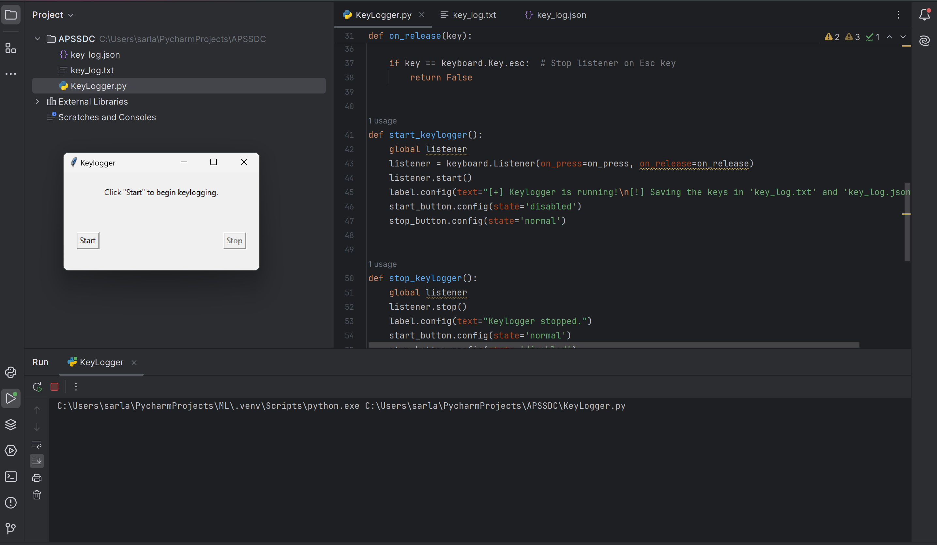

WHO ARE THE END USERS?
Parental Monitors
Investigators
Employers
Security professional
Educational Institutes
3/21/2024 Annual Review

Slide 7

YOUR SOLUTION AND ITS VALUE PROPOSITION
Solution Overview:
1. Ethical Keylogger: Developed in Python for responsible monitoring.
2. Key Features: Accurate logging, secure storage, and user-friendly interface.
3. Value Proposition: Ensures safety, productivity, and privacy for users.
4. Conclusion: Balances functionality with ethical standards, serving diverse needs.
3/21/2024 Annual Review

Slide 8

THE WOW IN YOUR SOLUTION
Wow Factor:
- Stealthy Elegance: Operates discreetly while maintaining a sophisticated user experience.
- Uncompromising Security: Utilizes encryption and ethical guidelines to safeguard data with integrity.
- Empowering Insights: Provides invaluable insights into user behavior for enhanced safety and productivity.
- Ethical Ingenuity: Demonstrates a pioneering approach to monitoring that prioritizes privacy and responsibility.
3/21/2024 Annual Review
8

Slide 9
MODELLING
Teams cam add wireframes
Modelling and Wireframes Collaboration:
- Seamless Integration: Enables teams to seamlessly integrate wireframes into the modelling process, fostering a cohesive design workflow.
- Visual Representation: Enhances understanding through visual representations of the proposed solution, promoting clarity and alignment among team members.
- Iterative Development: Facilitates iterative development by allowing for quick adjustments and feedback loops based on wireframe prototypes.
- Efficiency and Accuracy: Streamlines the design process, leading to more efficient and accurate modelling outcomes while ensuring the final product meets user needs effectively.
3/21/2024 Annual Review
9

Slide 10
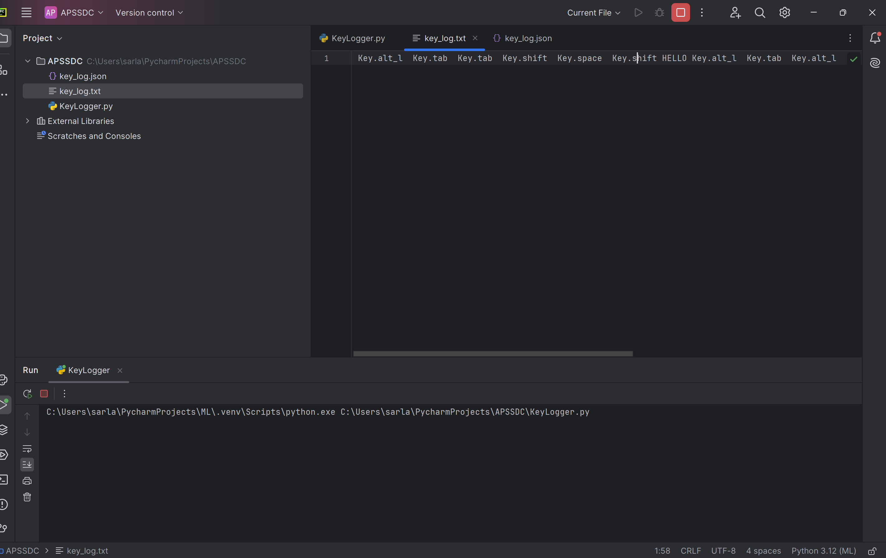

RESULTS
After clicking the start button and typing any thing It will be recorded in the key.txt as shown above
3/21/2024 Annual Review
10

